Slide 1
Tech Layoffs
2020-2024
By: Vesethmollyka VAR
Professor: Anahid BAUER
Course: Application of Statistics

Slide 2
Table of Contents
01
02
03
04
Overview
Study Questions
Analysis
Key Takeaways

Slide 3

Tech Industry
Continuous growth and transformative innovations
Workforce Challenges:
Rapid industry growth leading to concerns
Inevitable rise of automation and AI
Potential job displacement and operational improvements
Impact of External Factors:
Economic downturns & market shifts
Influencing demand for tech products & services
Common start-up failures => employment layoffs

Slide 4
Layoffs 2020-2024
15%
15%
Mean layoff rates
<1%
<1%
Vary layoff rates
267
267
Individuals laid annually

Slide 5
How do the patterns of layoffs in the tech industry from 2020 to 2024 differ across continents?
Does the company size correlate with layoffs during this timeframe?

Slide 6





Description of Data
Data by Roger Lee
1418 observations and 16 variables
Summary | Min. | 1st Q | Median | Mean | 3rd Q | Max
# Laid Offs | 3.0 | 40.0 | 86.0 | 267.4 | 200.00 | 12000.0
Company Size before Layoffs | 4.0 | 213 | 531 | 3556 | 1415 | 400000.0

Slide 7
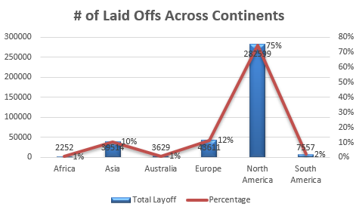
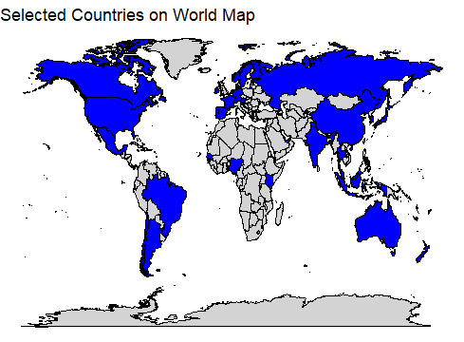
Regional Variations in Layoffs
37 Countries, 6 Continents, 379162 Laid Off

Slide 8
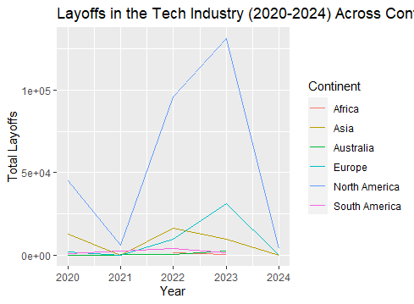
Regional Variations in Layoffs
2020: 61960
2021: 6790
2022: 129031
2023: 177026
2024: 4355
The highest number of layoffs occurred in North America with a total of 282599.
The data indicates that North America, Europe and Asia faced more significant challenges in terms of job losses.

Slide 9
Company Size-Layoffs Correlations
Strategic Planning
Industry Evaluation
It enables them to anticipate potential staffing challenges based on their scale, facilitating proactive measures to mitigate risks or capitalize on opportunities.
This knowledge is valuable for stakeholders in assessing which sectors may be more susceptible or resilient to economic downturns, technological shifts, or other disruptive factors.
Economic Assessment
Support Measures
The correlation provides insights into the economic impact of layoffs across different-sized companies.
Identifying the correlation informs the design and implementation of targeted support measures.

Slide 10
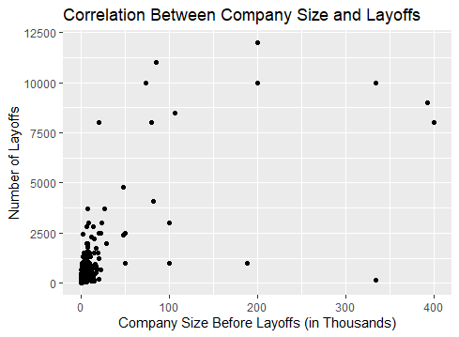
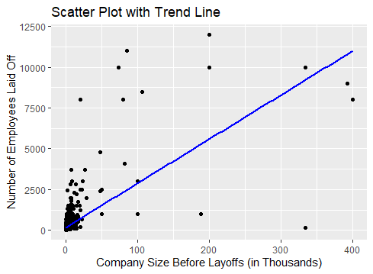
Company Size-Layoffs Correlations
Correlation coefficient: 0.6943 => strong positive correlation suggests larger companies tend to have higher number of layoffs
Skewness value = 13.61; Kurtosis value = 206.17 => not symmetrical

Slide 11
Company Size-Layoffs Correlations
T-test | 36.302
df | 1416
P-value | <0.00000000000000022
Confidence Interval (95%) | [0.6663213, 0.7203179]
Correlation coefficient | 0.6942954
The low p-value and positive sample estimate provided strong evidence => positive correlation between company size before layoffs and the number of layoffs from 2020 to 2024.

Slide 12
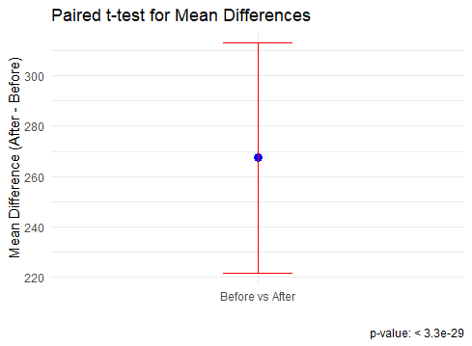
Company Size-Layoffs Correlations
T statistics: 11.475
Mean difference: 267.3921
Regression Equation:
Laid Off = 171 + 0.0271 * Com. Size before Layoffs
Assumptions: linearity, independence, homoscedasticity, and normality of residuals
Significant positive relationship between company size before layoffs and the number of layoffs
The regression model explains 48.2% of the variability in layoffs

Slide 13
Key Takeaways
Regional Variations
Correlations
The tech industry layoffs from 2020 to 2024 varied across continents with North America experiencing the highest number of layoffs followed by Europe and Asia.
There is a significant positive correlation between company size before layoffs and the number of employees laid off. Larger companies tend to have higher numbers of layoffs.
Regression Model
Implications
The model explains approximately 48.2% of the variation in layoffs, indicating that company size is a significant factor in determining the number of employees affected by layoffs.
The findings highlight the need for proactive measures to address the challenges faced by the tech industry, such as reskilling and upskilling programs.

Slide 14
Thanks
Do you have any questions?

